Slide 1

Chapter 8 Blood and Blood Spatter
By the end of this chapter you will be able to:
Explain the composition of blood
Describe the function of blood cells
Determine the blood type of a blood sample
Conduct a blood spatter analysis
Examine wounds and describe the nature of the weapon
Find and process blood evidence
All Rights Reserved South-Western / Cengage Learning © 2012, 2009

Slide 2
Introduction and History
Blood typing provides class evidence
DNA profiling provides individual evidence
A blood splatter pattern provides information
  the truthfulness of an account by a witness or a suspect
  the origin of the blood
  the angle and velocity of impact
  the type of weapon used

Slide 3
Composition of Blood
RED BLOOD CELLS (Erythrocytes) – The most abundant cells in our blood; they are produced in the bone marrow and contain a protein called hemoglobin that carries oxygen to our cells.
WHITE BLOOD CELLS (Leukocytes) – They are part of the immune system and destroy infectious agents called pathogens.
PLASMA – This is the yellowish liquid portion of blood that contains electrolytes, nutrients and vitamins, hormones, clotting factors, and proteins such as antibodies to fight infection.
PLATELETS (Thrombocytes) – The clotting factors that are carried in the plasma; they clot together in a process called coagulation to seal a wound and prevent a loss of blood.

Slide 4
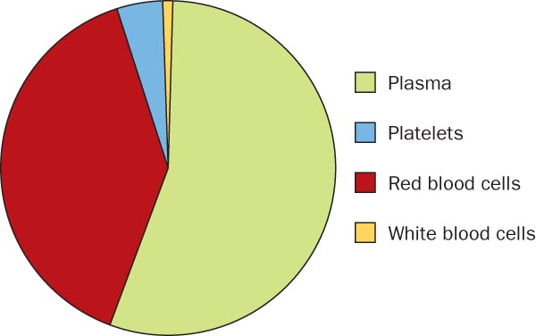
Composition of Blood

Slide 5
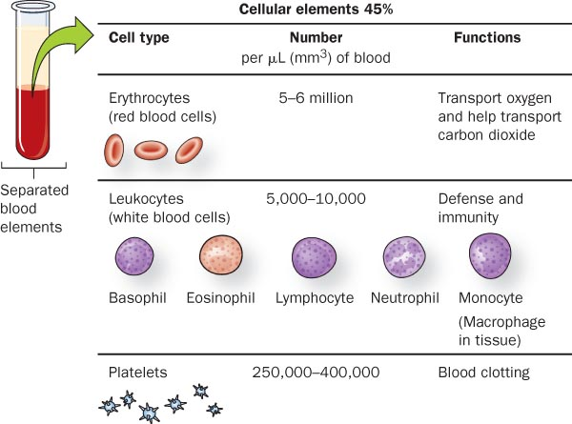
Cellular Components of Blood

Slide 6
Blood Facts
The average adult has about FIVE liters of blood inside of their body, which makes up 7-8% of their body weight.
Blood is living tissue that carries oxygen and nutrients to all parts of the body, and carries carbon dioxide and other waste products back to the lungs, kidneys and liver for disposal. It also fights against infection and helps heal wounds, so we can stay healthy.
There are about one billion red blood cells in two to three drops of blood. For every 600 red blood cells, there are about 40 platelets and one white cell.
http://www.bloodbankofalaska.org/about_blood/index.html

Slide 7
Blood Typing—Proteins
Discovered in 1900 by Karl Landsteiner
Identifies the presence or absence of particular proteins embedded in the cell
Quicker and less expensive than DNA profiling
Produces class evidence but can still link a suspect to a crime scene or exclude a suspect
Genes determine your blood type by causing proteins called AGGLUTINOGENS to exist on the surface of all of your red blood cells.

Slide 8
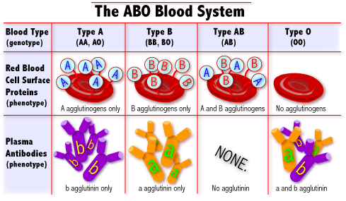
What are blood types?
Blood Types
AA or AO = Type A
BB or BO = Type B
OO = Type O
AB = Type AB
There are 3 alleles or genes for blood type: A, B, & O. Since we have 2 genes, there are 6 possible combinations.
http://learn.genetics.utah.edu/units/basics/blood/types.cfm

Slide 9
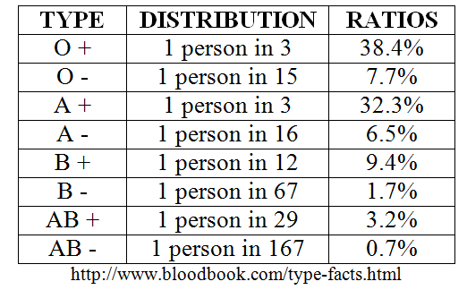
How common is your blood type?
46.1%
38.8%
11.1%
3.9%

Slide 10
Blood Transfusions
A blood transfusion is a procedure in which blood is given to a patient through an intravenous (IV) line in one of the blood vessels. Blood transfusions are done to replace blood lost during surgery or a serious injury. A transfusion also may be done if a person’s body can't make blood properly because of an illness.
Who can give you blood?
People with TYPE O blood are called Universal Donors, because they can give blood to any blood type.
People with TYPE AB blood are called Universal Recipients, because they can receive any blood type.
Rh + → Can receive + or -
Rh - → Can only receive -
Universal Donor
O
A
B
AB
Universal Recipient

Slide 11
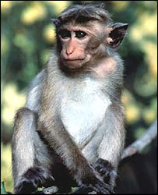
Rh Factors
Scientists sometimes study Rhesus monkeys to learn more about the human anatomy because there are certain similarities between the two species. While studying Rhesus monkeys, a certain blood protein was discovered. This protein is also present in the blood of some people. Other people, however, do not have the protein.
The presence of the protein, or lack of it, is referred to as the Rh (for Rhesus) factor.
If your blood does contain the protein, your blood is said to be Rh positive (Rh+). If your blood does not contain the protein, your blood is said to be Rh negative (Rh-).
A+ A-
B+ B-
AB+ AB-
O+ O-
http://www.fi.edu/biosci/blood/rh.html

Slide 12
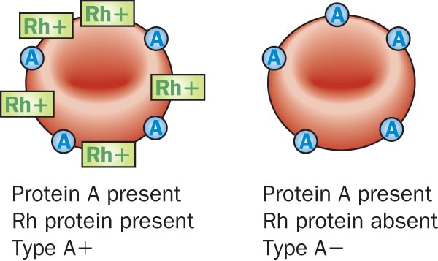
Rh Factor
85% of the population has a protein called
RH factor on their blood cells

Slide 13
Blood Typing
—Probability and Blood Types
The probability of a blood type equals the product of probabilities for each protein group
  If Type A = 42% and Rh Factor = 85%
  Then A+ = .42 x .85 = .357 (35.7%)
Knowing additional proteins and enzymes in the blood sample
  Narrows the population group
  Increases the probability of identifying a suspect

Slide 14
Blood Evidence
Blood samples – Can be analyzed to determine blood type and DNA, which can be matched to possible suspects.
Blood droplets – Can be analyzed to give clues to the location of a crime, movement of a victim, and type of weapon.
Blood spatter – Can be analyzed to determine patterns that give investigators clues to how a crime might have happened.

Slide 15
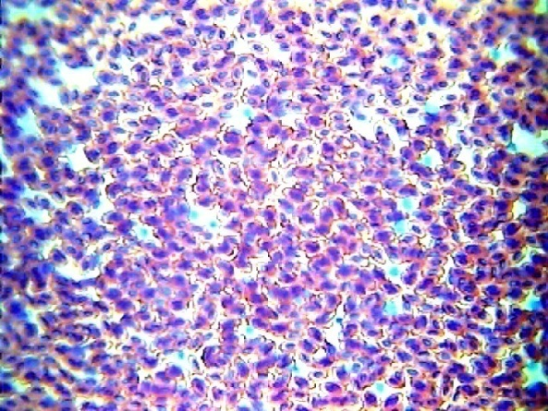
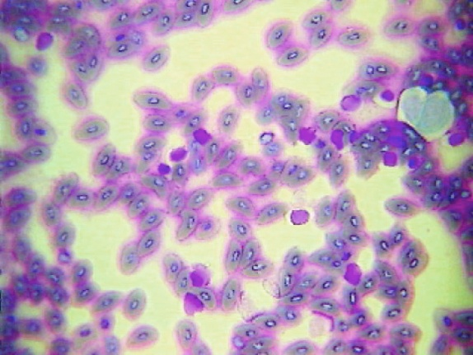
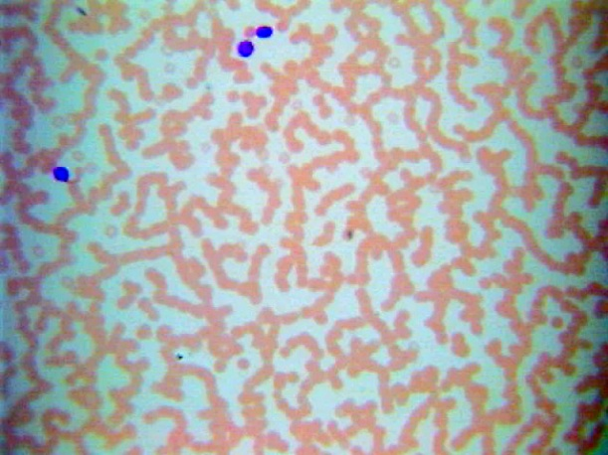
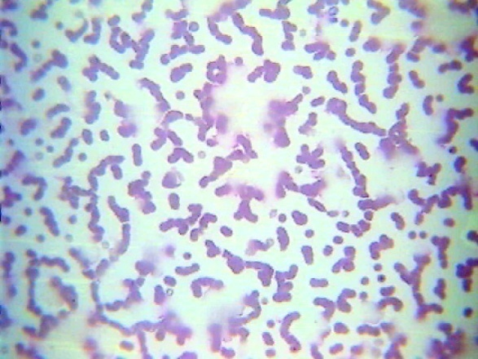
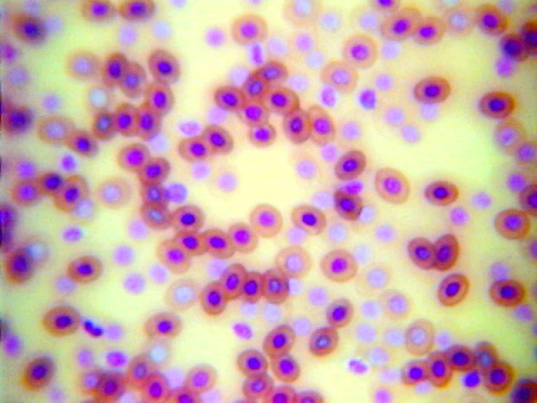
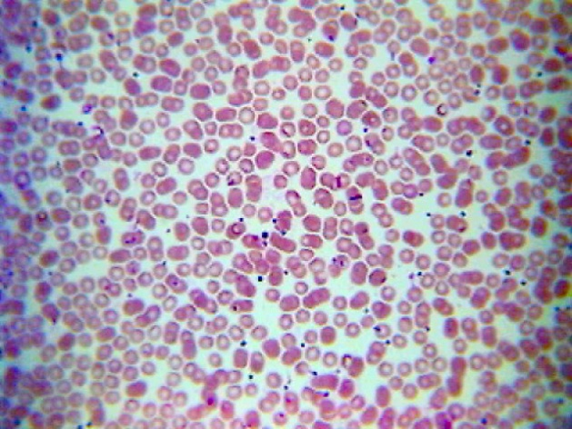
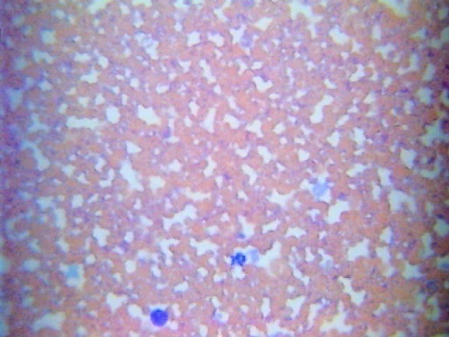
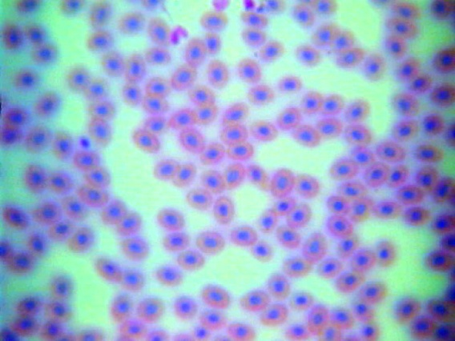
Microscopic
Views
Bird Blood
Fish Blood
Horse Blood
Cat Blood
Frog Blood
Human Blood
Dog Blood
Snake Blood

Slide 16
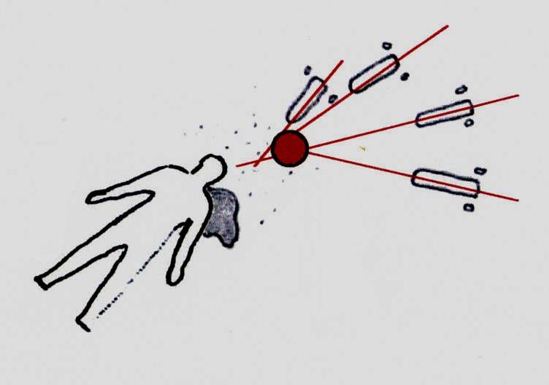
Blood Splatter
1939—splatter patterns first
analyzed
Blood may splatter when a wound is inflicted
Blood splatter pattern—a grouping of blood stains
Patterns help to reconstruct the events surrounding a shooting, stabbing, or beating

Slide 17
Blood Splatter Analysis
Analysis of a splatter pattern can aid in determining the:
  direction blood traveled
  angle of impact
  point of origin of the blood
  velocity of the blood
  manner of death

Slide 18


Blood Splatter Analysis
Natural cohesiveness of blood

Slide 19
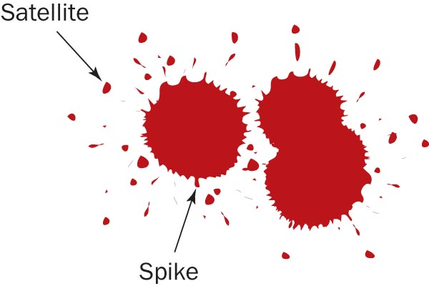
Blood Splatter Analysis
Satellite droplets—
  When blood falls from a height, or at a high velocity,
  It overcomes its natural cohesiveness, and
  Separates from the main droplet
Spiking patterns—
  Form around the droplet
  edges when blood falls
  onto a less-than-smooth
  surface

Slide 20
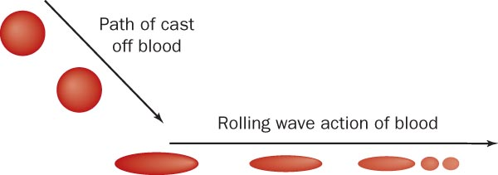
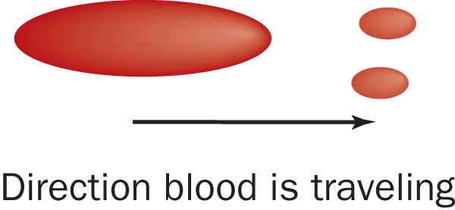
Blood Splatter Analysis
—Directionality
The shape of an individual drop of blood provides clues to the direction from where the blood originated.
How will the point of impact compare with the rest of a blood pattern?

Slide 21
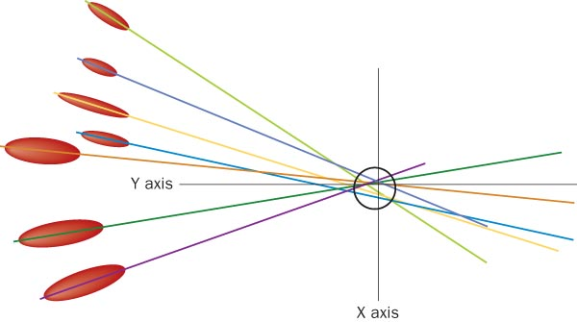
Blood Splatter Analysis
Lines of convergence—two or blood splatters can pinpoint the location of the blood source

Slide 22


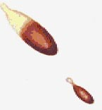

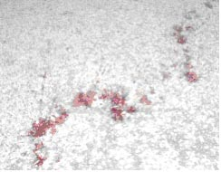
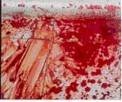
Blood Splatter Analysis
—Six Patterns
Describe each of these:
  Passive drops
  Arterial gushes
  Splashes
  Smears
  Trails
  Pools

Slide 23
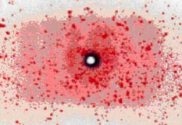

Blood Splatter Analysis
—Impact
Patterns can help investigators determine the type of weapon used
What kind of a pattern is produced by a gun shot?
What kind of a pattern is produced by a hammer blow?

Slide 24
Crime Scene Investigation
of Blood
Search for blood evidence
Determine
  Is the evidence blood?
  Is the blood human?
  What is the blood type?
Interpret the findings:
  Does the blood type match a suspect’s blood?
  If not, exclude that suspect
  If yes, decide if DNA profiling is necessary

Slide 25
. . . . . . . . . . . . . . . . . Summary
Blood consists of cellular components and plasma.
The various human blood types are caused by the presence or absence of A and/or B proteins on the surface of red blood cells.
Blood splatter evidence can be used to recreate a crime scene.
Investigators endeavor to (a) locate, (b) identify, and (c) interpret blood splatter patterns at crime scenes.

